Slide 1
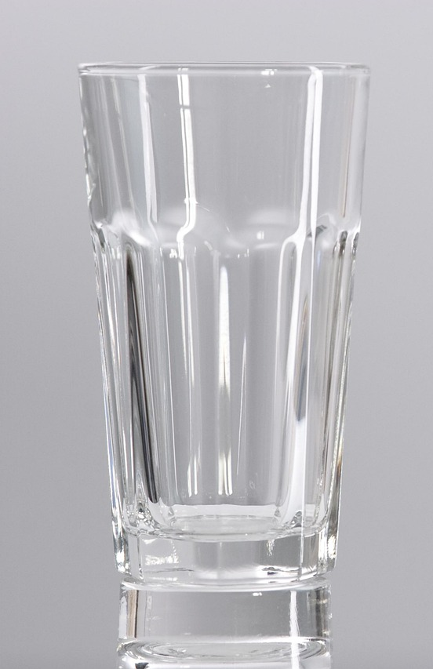
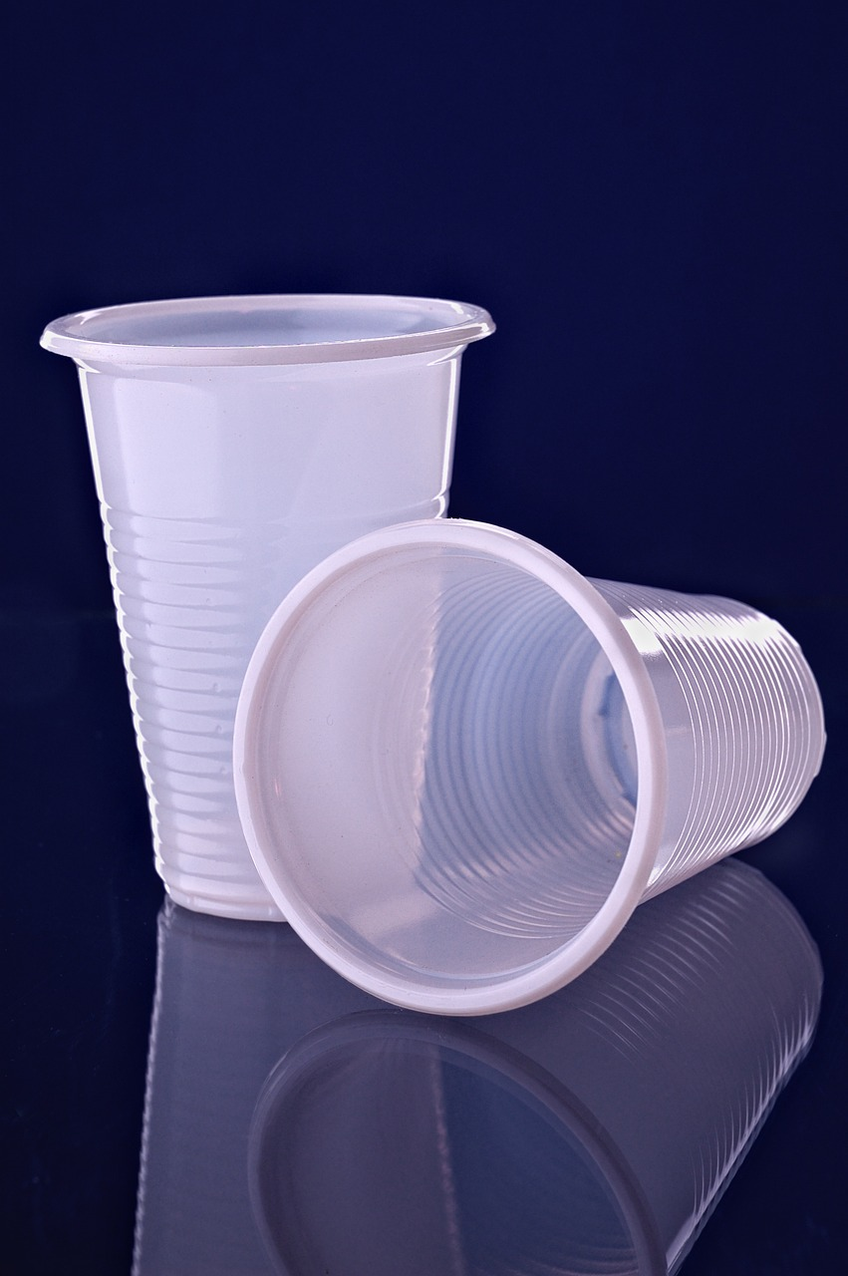

Materials
Everything around us is made of materials.
The material is what an object is made of, for example a cup can be made of glass, plastic or paper. Materials can be natural (found in nature), or synthetic (made by humans).The material that we choose to make an object from depends on its purpose. Understanding materials helps us select the right one for different uses, with the use depending on the property of
the material.
Polymers
polymer
A polymer is a long chain molecule made of repeating units called monomers.
monomer
glass cup
plastic cup
paper cup
Polymerisation is the joining of monomers to form polymers.
Natural polymers occur naturally and are found in plants and animals e.g. cellulose in plant cell walls, starch in potatoes, wool from sheep, chitin that forms exoskeletons.
Synthetic polymers are manufactured using chemicals taken from crude oil e.g. polyester and nylon used in clothing, PVC used to make rain gutters, polyethene used for plastic bags.
Ceramics
A ceramic is a non-metallic material that is formed by heating and cooling a soft substance, which transforms it into a hard material.
Clay ceramics are made by shaping wet clay while it's soft and then heating it to a high temperature and allowing it to cool, which causes it to harden.
An increased population increases demand for resources and raw materials. Raw materials, which are natural resources that are used to make other things, are running out e.g. crude oil used to manufacture synthetic polymers.
Competition for and the reduction of raw materials like crude oil has ethical, social, economic and political consequences.
Property | Examples of uses
hard | vases, statues and many other objects
strong when compressed | bricks used for building structures
good electrical insulators | outdoor electrical power-line insulators
non-reactive with water | mugs and dishes
resistant to chemicals | kitchen and bathroom tiles
high melting points | oven baking dishes, jet engine turbine blades
Ceramics are brittle, so they cannot be bent, and they shatter or break when hit, dropped, or if too much force is applied.
Polymers have common properties, like being in the solid state at room temperature.
Property | Examples of uses
good electrical insulators | casing around electrical wires
chemically unreactive | food containers
durable | shopping bags
mouldable | Plastic bottles
Science | 7.07 – Materials | Knowledge Organiser
Notes:
Images:
Plastic cup (CC0) - https://pixabay.com/photos/disposable-ware-liquid-recycling-4969583/
Glass cup (CC0) - https://pixabay.com/photos/cup-mug-water-glass-1230651/
Paper cup (CC0) - https://pixabay.com/photos/coffee-americano-cup-paper-cup-2354130/
Polymer diagram – United Learning (AYU)

Slide 2
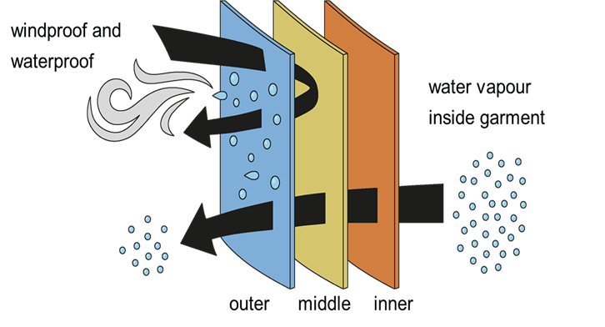
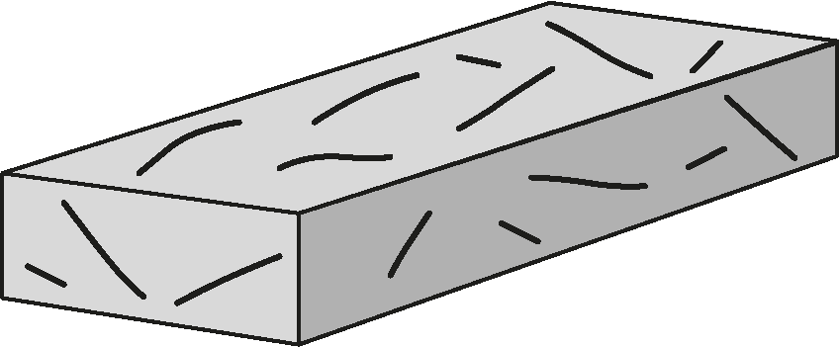
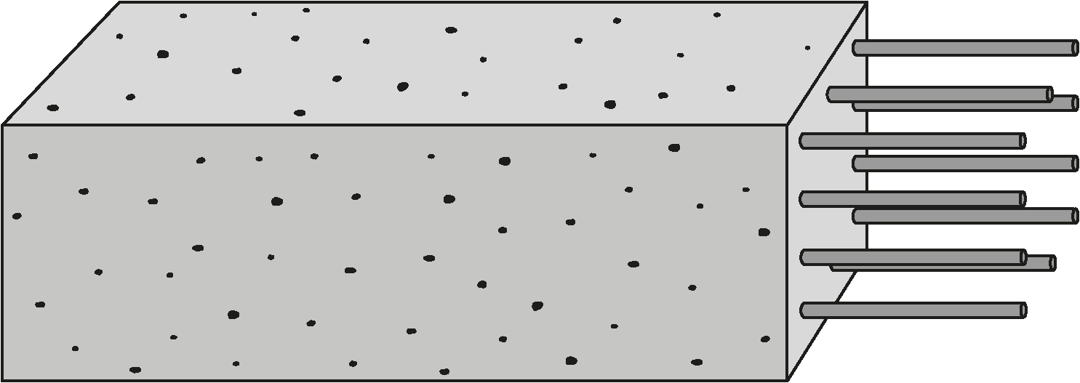
Materials
Polymers (continued)
Composite materials (continued)
Polymers can have very different properties.
Polymers can have different properties when they are made of different monomers. This is because different monomers have different properties.
Polymers can also have different properties when they have different length chains lengths. Longer polymer chains have higher melting points and are stronger.
The properties of composites make
them suitable for specific applications
e.g. breathable fabric used for
outdoor activities.
The exact properties and behaviour of a composite material will depend on:
choice of materials
the amounts used of each material
the way each material is structured within the new composite material.
Plastics and polymers can cause environmental and
health problems:
Many polymers take hundreds of years to degrade, accumulating in landfills and oceans.
Improper disposal and littering of polymer products cause widespread pollution.
Polymer chemicals may disrupt reproduction in organisms.
Global efforts like the plastic bag charge are being taken to address polymer-related environmental issues.
Polymers can be reused, recycled, incinerated, or sent to landfill. Each method has advantages and disadvantages,
e.g. landfill takes up space and releases harmful gases.
Fibreglass is a composite material because it is made from glass fibres and a plastic polymer, which are two different materials.
Fibreglass is strong in tension, lightweight and stiff. It is used for making kayaks and car body panels.
Reinforced concrete is a composite material because it is made from concrete and steel, which are two different materials.
Reinforced concrete is strong in
compression and tension. It is used for construction and for building.
glass fibres
plastic polymer
Composite materials
concrete beam
steel rods
A composite material is a material that is made from two or more different types of material.
The materials for a composite material are chosen because they have different properties that combine to make a more useful material with improved properties.
material | property
glass fibres | strong in tension and lightweight
plastic polymer | weak in tension and stiff
Each material in a composite keeps its original properties, and the properties of those materials complement
one another.
material | property
concrete | strong in compression
steel | strong in tension
Science | 7.07 – Materials | Knowledge Organiser
Notes:
Images:
All images – United Learning

Slide 3
Materials
Scientific methods
Developing technology through scientific knowledge
Scientists use a scientific method to collect high-quality data to explain observations and answer questions.
A scientist might choose any of the four scientific methods:
Testing a hypothesis by changing variables e.g. smoother surfaces cause less friction to act on objects sliding over them.
Testing a hypothesis without changing variables e.g. as age increases, the likelihood of developing arthritis increases.
Experimenting by changing variables without testing a hypothesis e.g. testing different elements to classify them as metals or non-metals.
Observing phenomena without changing variables or testing a hypothesis e.g. biologists observing cells or astronomers observing planets.
Scientific advances have enabled workers in Science, Technology, Engineering, and Mathematics (STEM) fields) to further technology and industry by developing new tools and machines, and by making the production of goods in large quantities possible.
For example, being able to create new composite materials such as fibreglass has led to their use for car body panels, and these are mass produced, made in large quantities, every day.
Developing scientific knowledge through technology
Technology developments have allowed scientists to learn more about materials.
Measurement error
Technology | What it allows scientists to do
Electron microscope | See the structure of materials down to the level of each atom.
Computer simulations | Simulate how ceramics behave under different conditions.
Three-dimensional (3D) printing machines | Quickly produce prototypes and test new ceramic designs.
Random error is a measurement error that arises unpredictably from the experimental environment and cannot be controlled. As it is unpredictable, random error cannot be removed or corrected.
But the impact of random error can be minimised by taking multiple measurements, ignoring any anomalies and calculating a mean.
Conclusions
Advancements in technology have improved scientific research by providing scientists with many ways of collecting high-quality data and communicating.
Computer simulations allow scientists to test materials under different conditions.
Cloud-based platforms (online tools) allow scientists all over the globe to communicate and collaborate.
It is important that a conclusion is based on the observed data and trends without making over-generalisations that extend beyond the scope of the experiment. This makes the conclusion more reliable. E.g. when testing polymer strengths, a statement such as “polymer C is always stronger than polymer B” would be an over-generalisation.
Science | 7.07 – Materials | Knowledge Organiser

